Slide 1
Role of Gas Pipelines in Decarbonisation of EU Energy Sector
Barbara Jinks, Director Govt Relations
Gas Infrastructure Europe, Brussels
PTC Conference, Berlin 21 March 2019

Slide 2
What is role of TSOs in decarbonising energy?
C
Essential now …
… and beyond 2050
Higher efficiency with sector coupling
Large cost savings v new elec networks
Enables transition from nat gas to renew/decarb gases
Sector integration - optimise local resources
Increased renewable energy storage
Socially acceptable
Grid balancing & flexibility, SoS
Delivers affordable energy
Delivers fast emission reductions
Reliable energy supplier

Slide 3
Gas infrastructure is essential to decarbonise energy
Paris Agreement COP21 - 195 countries agreed to limit global warming to well below 2C cf 1990 temps
Challenge - net-zero carbon emissions by 2050
Problem – EU responsible for 10% global GHG emissions and energy responsible for 75% GHG emissions (and demand is growing)
Solution – decarbonised energy (gas and elec)
Affordable decarbonisation cannot be achieved without using the gas infrastructure
Notes:
2015 Paris Agreement: 195 countries agreed to limit global warming to well below 2C (aim for 1.5C) cf 1990 temperatures
To meet Paris target, need net-zero carbon emissions in EU by 2050
Problem - energy responsible for 75% GHG emissions (and demand is growing)
Energy needs to be net zero carbon
2017 Renewables 17.4% of EU final energy consumption last year, only marginally up from 17% 2016.
Insufficient progress in meeting 10% ren target in transport sector by 2020.
EU still on track to meet bloc-wide 20% by 2020, but “trajectories needed to meet national targets are becoming steeper.”
The EEA found that 20 EU countries are on track to reach their national renewable energy targets for 2020 — 5 less than 2016.
Solution - mix of decarbonised gas and electricity
But decarbonisation can not be achieved without gases and gas infrastructure
Gas infrastructure allows wider delivery of lower carbon gas and ren energy to all sectors

Slide 4
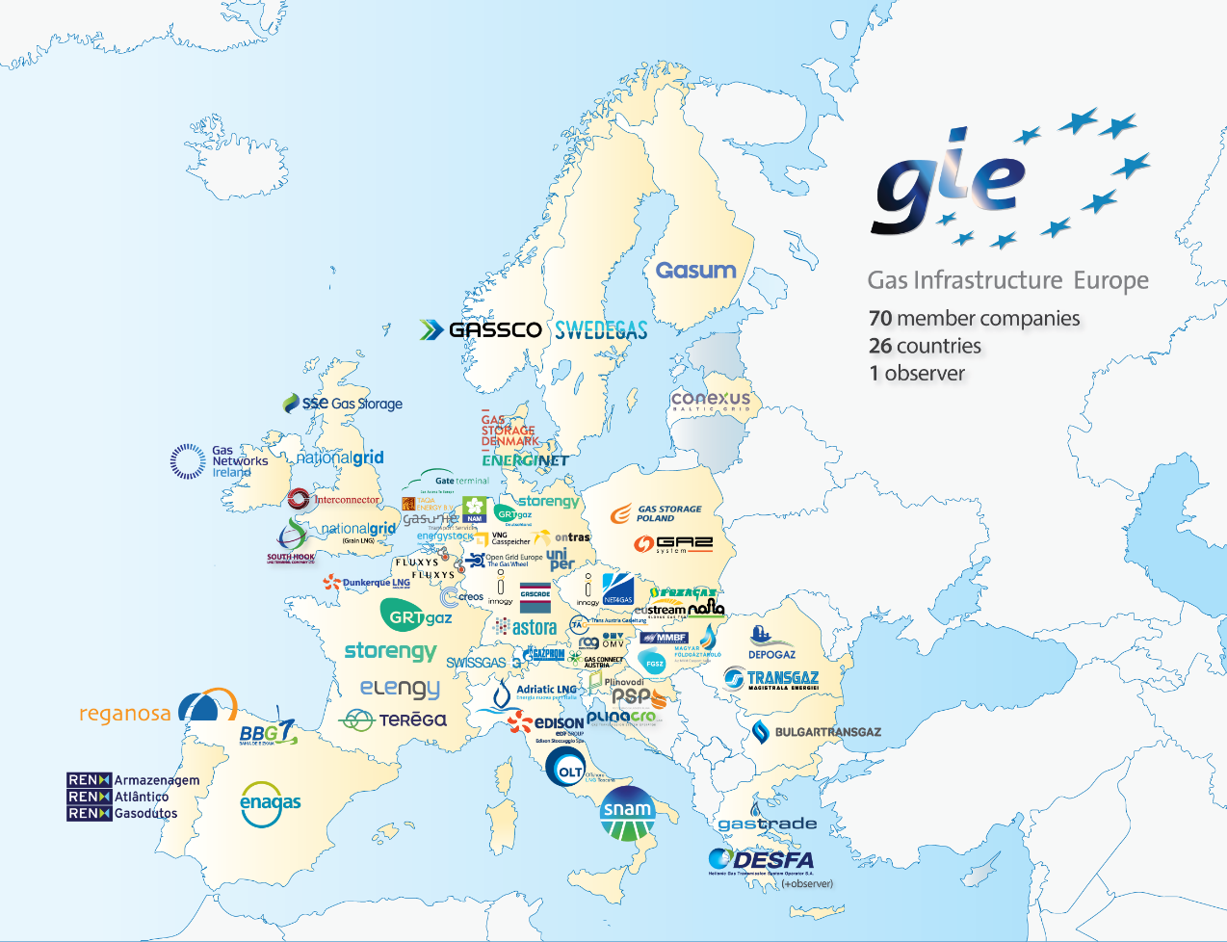
GIE – the Voice for Gas Infrastructure in Europe
GIE represents 69 members in 25 EU Member States.
GIE represents the sole interest of gas infrastructure operators under three columns:
Transmission (TSO)
Storage (SSO)
LNG (LSO)
GIE focuses on value created from our assets for consumers and users.
GIE works in focused Working Groups with Gas Package 2020.
Notes:
GIE is a European non-profit lobbying association established in 2005.
69 members in 25 countries
GIE represents the sole interest of the infrastructure industry in the gas business under three columns: transmission, storage and LNG.
BJ Director Govt Relations, Comms
GIE members offer solutions in 3 pillars
I will present overview of key activities in energy transition and the role of GIE representing the gas infrastructure >>>>>>>

Slide 5
Dispelling common myths about gas and pipelines
Not all gases are fossil - pipelines can transport renewable and decarbonised gases.
Gas pipelines are essential for the EU economy long term.
Gas-driven transport can reduce CO2 faster than e-mobility and HDV & ships need gases.
Pipelines essential for sector coupling - integrated gas/electric systems will decarbonise faster than all-electric.
Biomethane can be scaled up without conflicting with food and land use, and reduced emissions from agriculture activities.
There is no one silver bullet; we need different solutions and pathways for different in different countries and regions.

Slide 6
GIE - committed to achieving EU climate targets
Notes:
The gas>>>> infrastructure guarantees a safe, reliable network of decarbonised energy for power, heating and transportation,
>>> integration of all regions of Europe and
>>> innovation for cost-effective renewable energy.
GIE committed to Paris targets
- members offer solutions to the energy transition in EU
G- IE lobbies
Quick note about GIE >>>

Slide 7
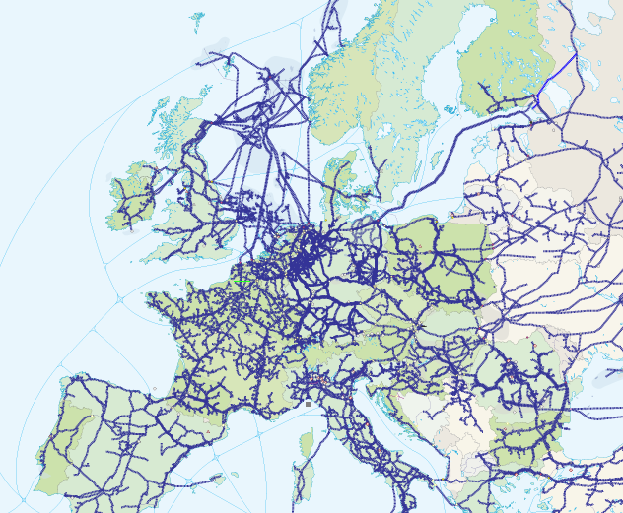
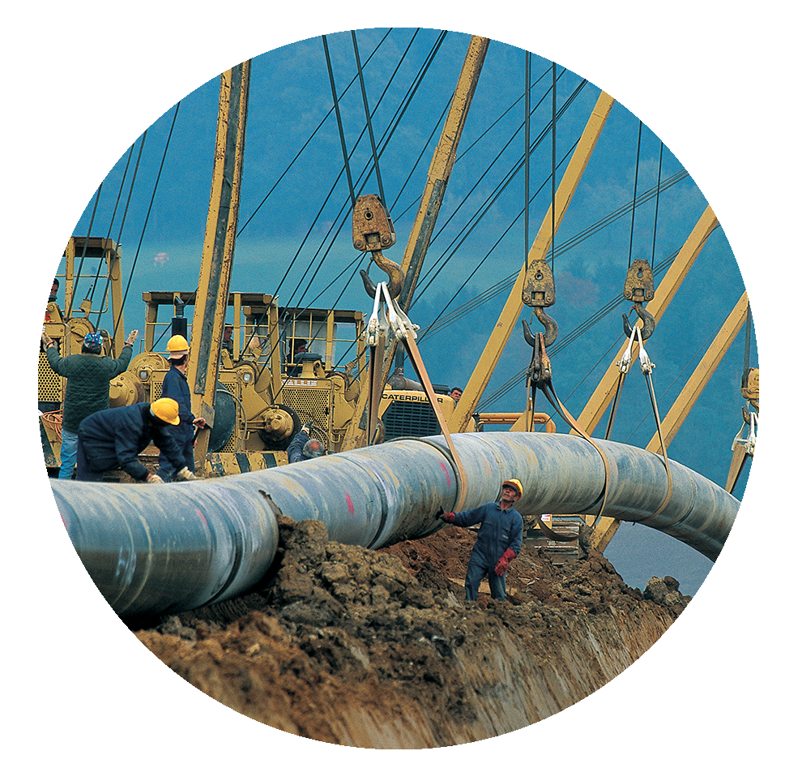
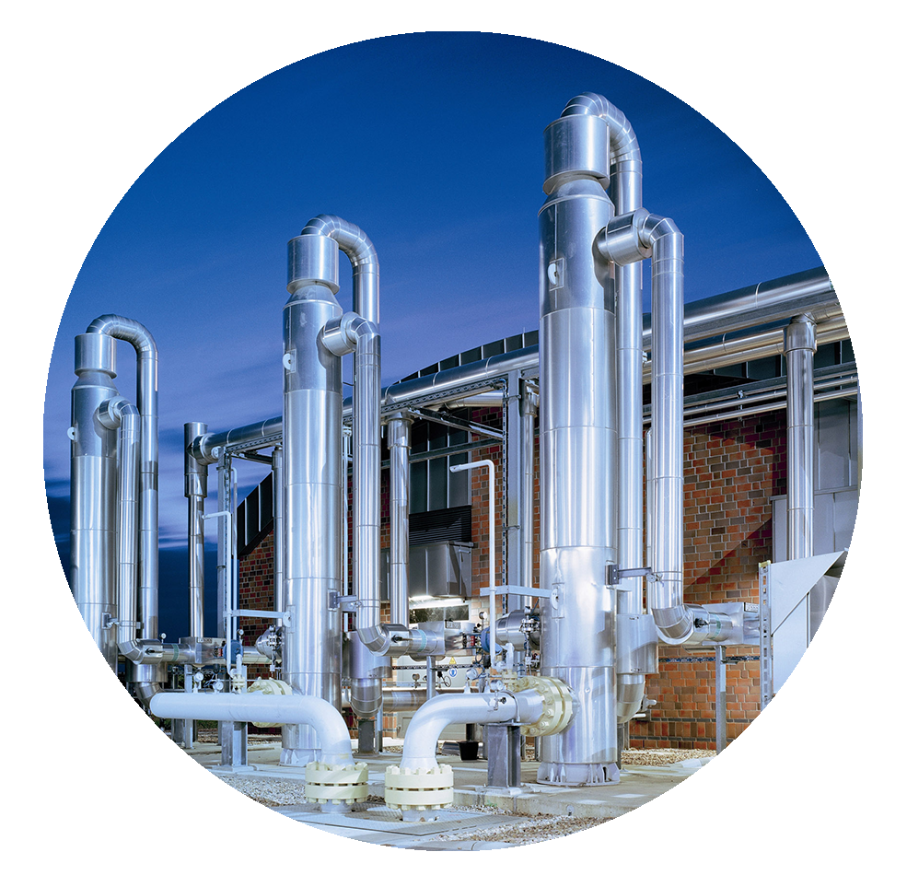
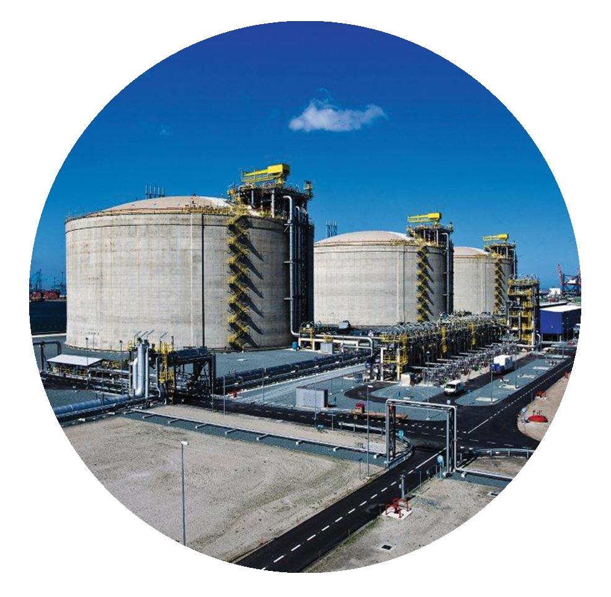
Reliable, secure affordable energy supply throughout EU
infrastructure
Cost effective way to decarbonise energy

Slide 8
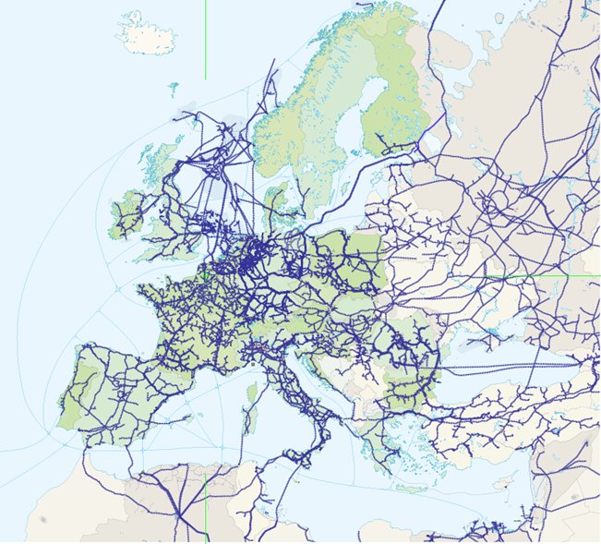
LNG, storage and gas transmission – reliable energy system connecting all Europe
Transmission pipelines
operational
under construction
planned
Data sources : European Environment Agency, ENTSOG TYNDP 2018, EuroStats 2016, GIE maps
GIE Member country
Notes:
Gas transports 10 x energy than elec across EU
Cross-border capacity in gas is 3 x total wind/solar energy produced in 1 year
Today ren is directed at power only – small sector
Gases can fuel heating, power, industry and transportation
“renewable” gas = all gases: lower, zero, negative carbon
Existing extensive network across EU and beyond
Interlinked;
Storage and transmission
Lng import terminals
SSLNG plants
Gas transports 10 x energy than elec across EU
Cross-border capacity in gas is 3 x total wind/solar energy produced in 1 year
Today ren is directed at power only – small sector
Gases can fuel heating, power, industry and transportation

Slide 9
Using gas infrastructure is a cost-effective way to decarbonise energy
Estimated savings for EU, based on higher share of bio/synthetic gas
and use of gas infrastructure vs all-electric scenario:
Pöyry 2018 Decarbonisation Study - €94 Bn pa savings
Ecofys (Navigant) 2018 Gas for Climate Study - €138 Bn pa savings
Eurogas 2018 PRIMES Study - €335 Bn total savings
Navigant 2019 Gas for Climate Study (update) - € 217 Bn pa saving
EU
Notes:
Also:DENA-Leitstudie (pilot study) - up to 600B€ savings to 2050 for Germany alone
The “optimised gas” scenario assumes that renewable and low carbon gas are used in a smart combination with renewable electricity

Slide 10
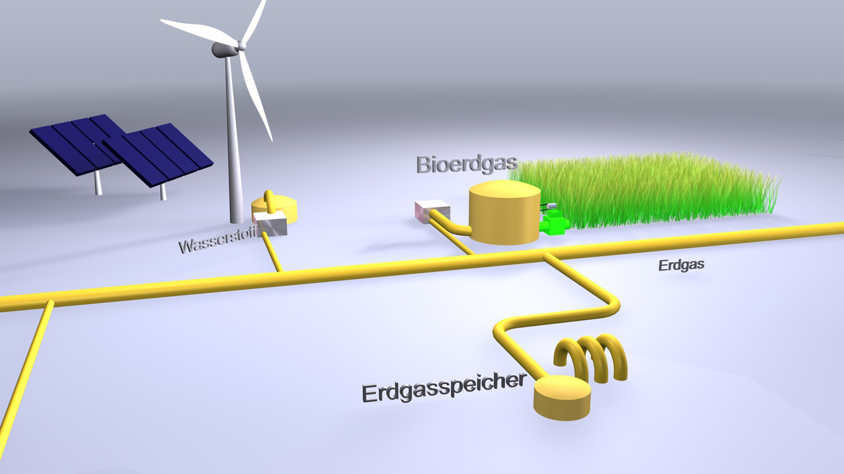
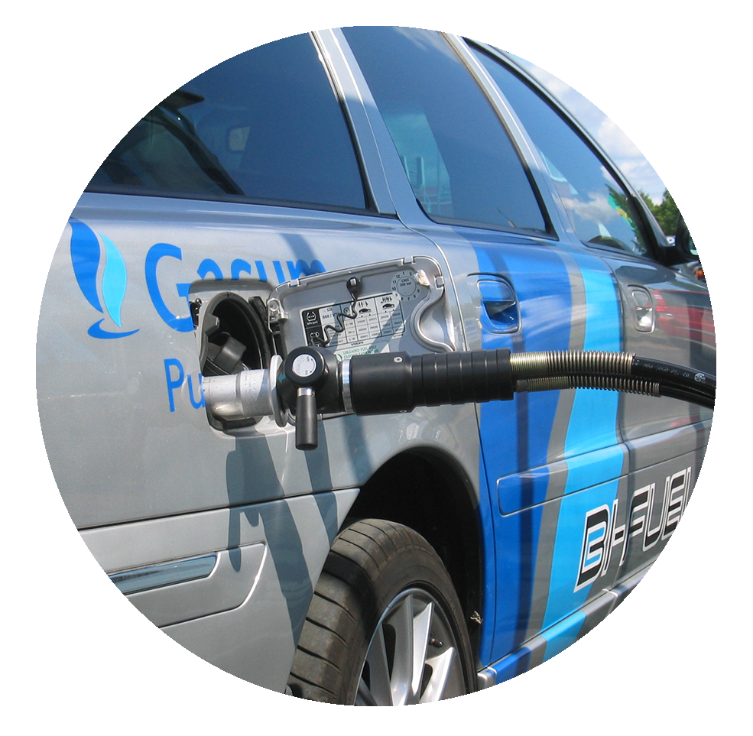
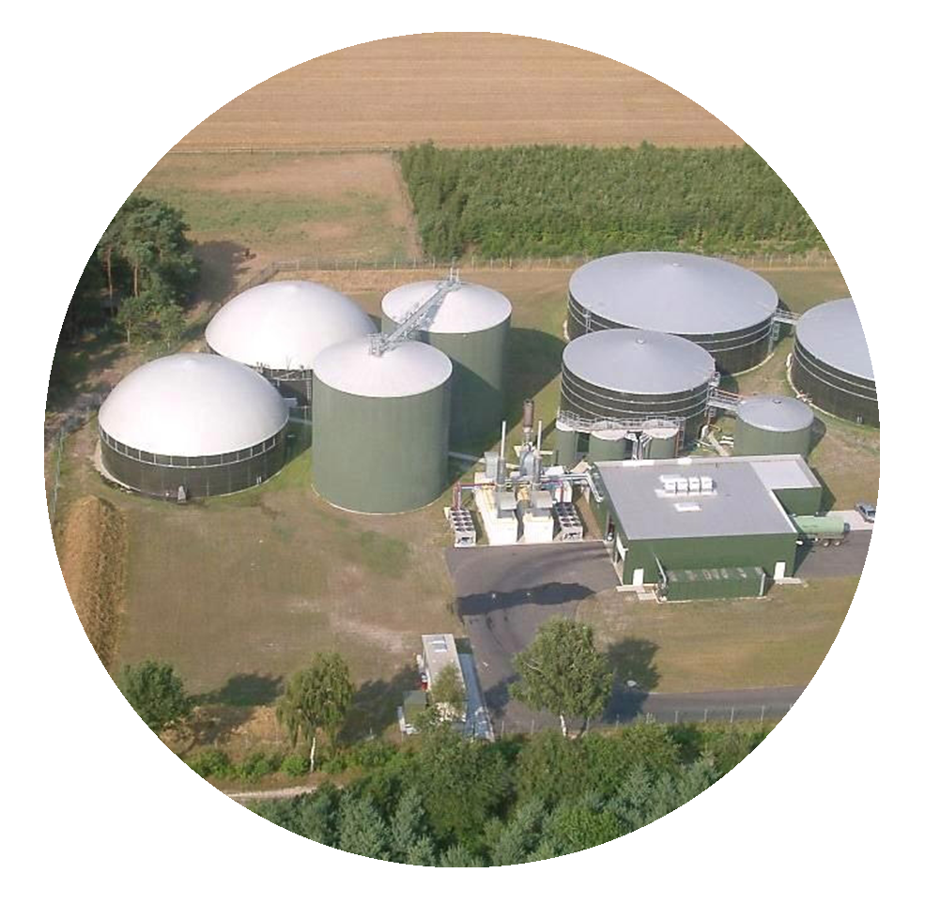
Facilitates a developed EU energy market
integration
Enables sector coupling and renewable energy storage
Notes:
Enables:
Integrated EU-wide gas system where energy flows freely without barriers, well before 2050
Well-interconnected, integrated market
All regions achieve comparable levels of market integration, competition, security of supply, liquidity and price convergence

Slide 11
Gas For Climate study March 2019: energy system can become fully renewable
Battery seasonal storage is unrealistic even at strongly reduced costs.
Full decarbonisation of high temp industrial heat requires gas.
Possible to sustainably scale-up renewable gas at strongly reduced production costs.
Blue hydrogen from natural gas with CCS can be a scalable and cost-effective option.
Potential for renewable hydrogen and biomethane to meet 80% demand (270 bcm).
Notes:
1,170 TWh renewable methane & 1,710 TWh hydrogen
270 billion cubic metres of natural gas (energy content).

Slide 12
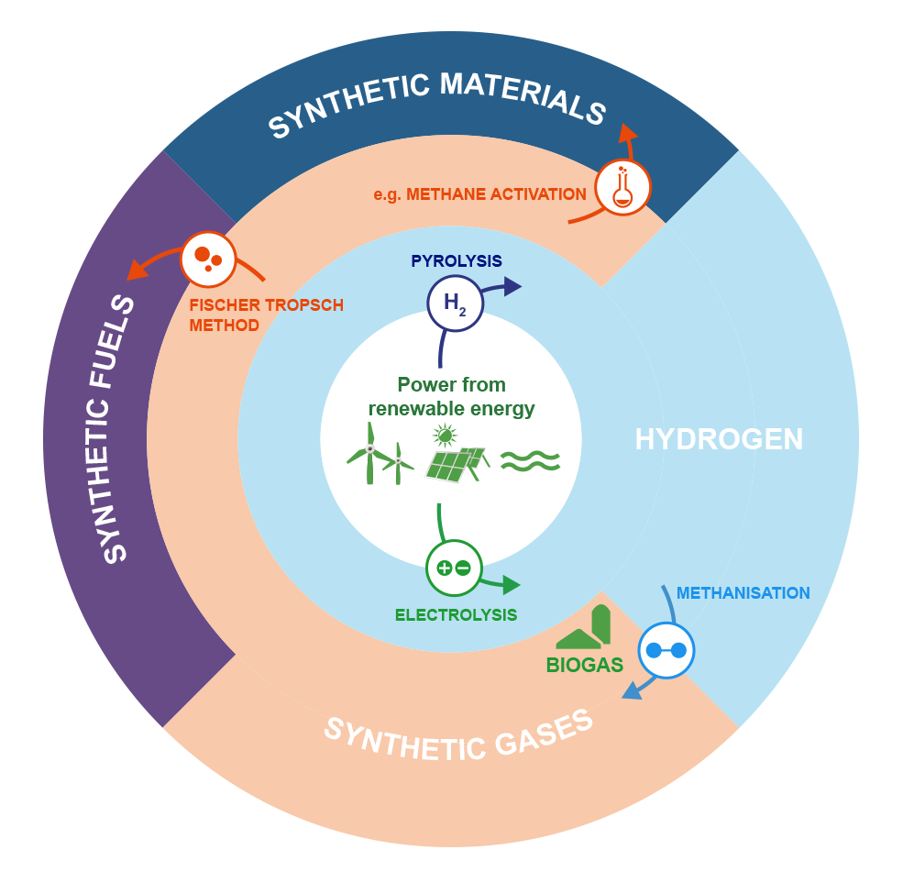
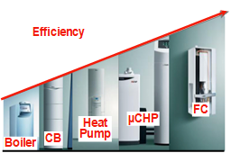
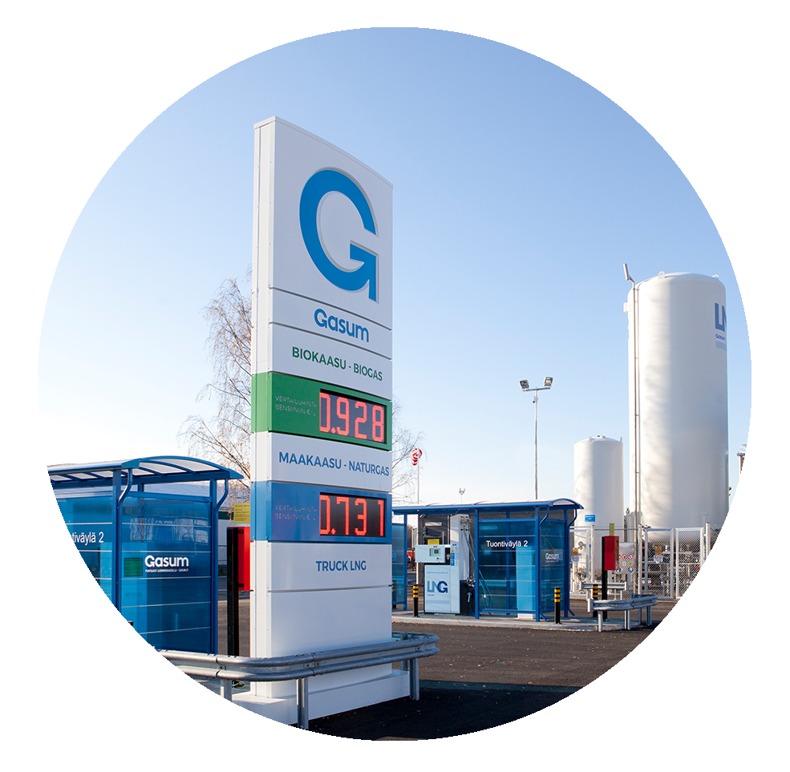
Gas infrastructure is ready for renewable & decarbonised gases
innovation
Facilitates increased energy efficiency with gas technology

Slide 13
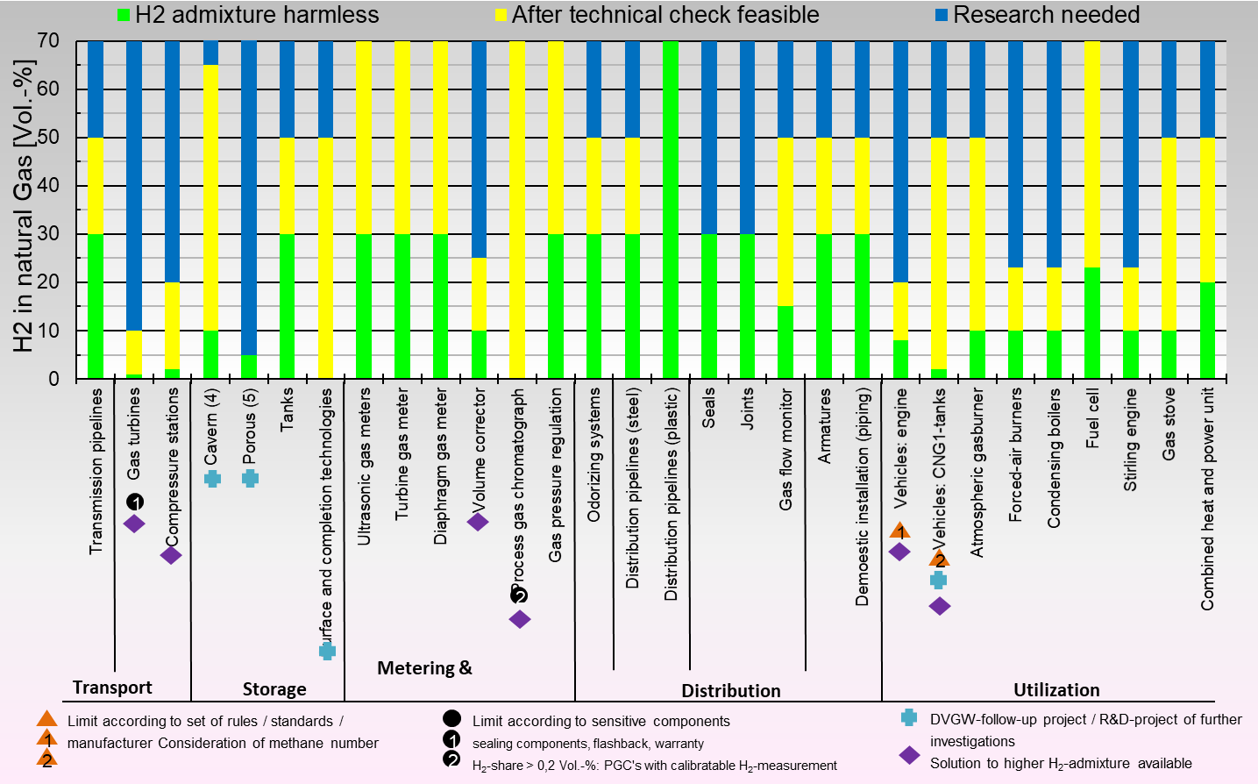
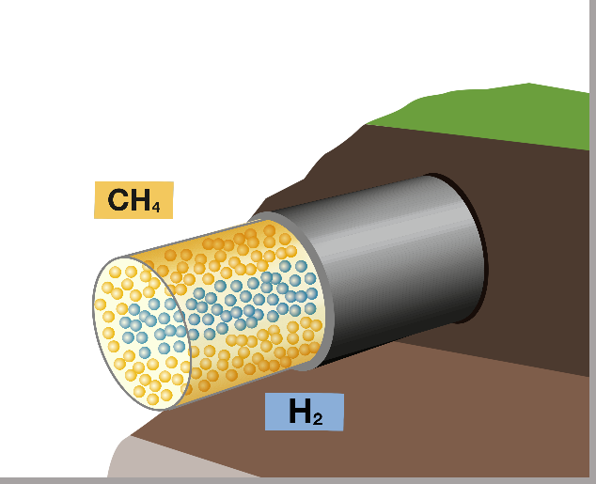
Innovation - the gas system is hydrogen-ready
No technical/physical bottlenecks to transporting hydrogen have been removed.
Max in EU is Germany at 10% allowed; full-scale tests aim for 20-25%.
Hydrogen transport within the gas grid creates a new virtual energy grid throughout Europe.
H2 pipeline carries 5x energy that electricity cable (nat gas x 15).
Source: DBI 2018
Notes:
Germany leading devt of H2 and mixing with gas (data 2018)
Chart shows ...
* green line across bottom
Yellow means solutions are possible
Blue – research underway
Since 2013 H2 being used in German gas network at 10%
Heading towards 20-25% and remove uncertainties
Distribution is 100% ready – key part of supply chain
Injection H2 needs cross border integration
Standardisation important
>>>
2015 studies showed bottlenecks – removed:
CNG tanks (new composite tanks)
Process chromatographs (tracer gas not helium, now argon)
Turbines (Siemens etch)
Underground storage (RAQ proved tests)
Germany leading devt of H2 and mixing with gas (data 2018)
Chart shows ...
* green line across bottom
Yellow means solutions are possible
Blue – research underway
Since 2013 H2 being used in German gas network at 10%
Heading towards 20-25% and remove uncertainties
Distribution is 100% ready – key part of supply chain
Injection H2 needs cross border integration
Standardisation importan

Slide 14
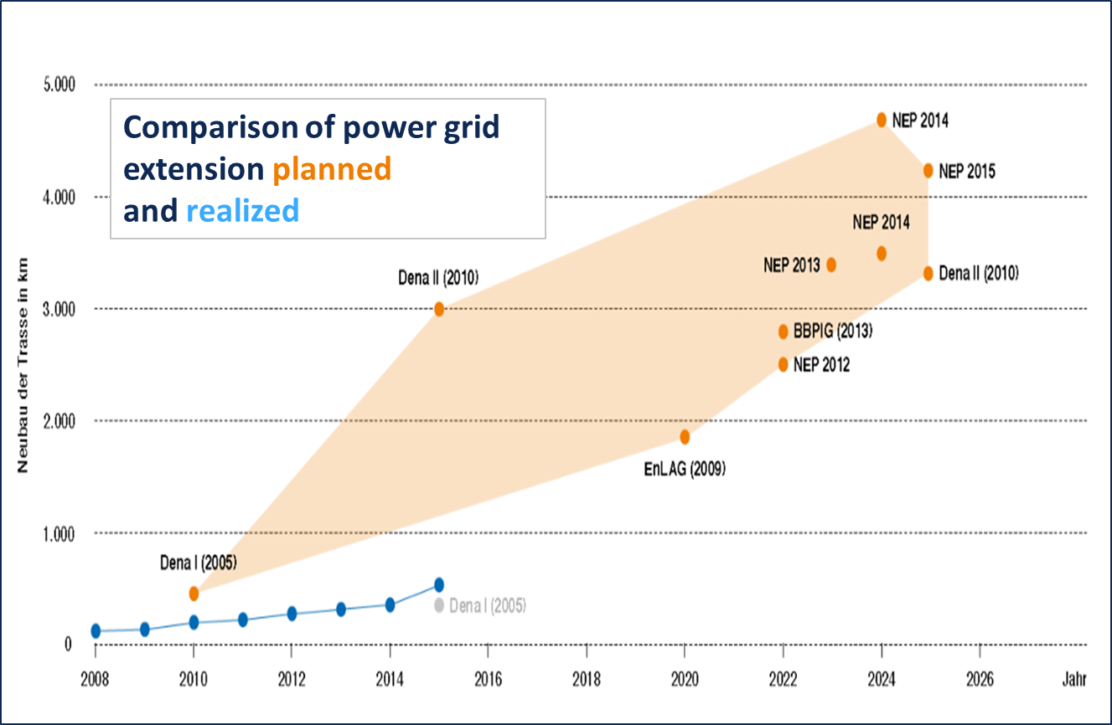
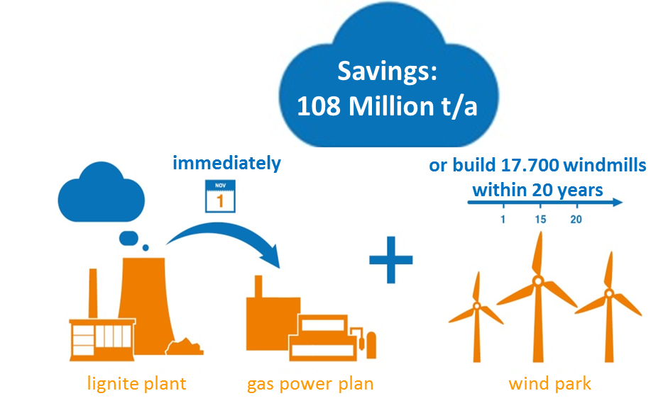
Why focus on hydrogen?
Relevance EU energy built mainly on molecules - climate action focusing on power segment insufficient.
Ability Electrification cannot deliver the high power peaks needed (seasonal and daily). Academics advise Paris Targets can only be achieved via hydrogen.
Speed Power grid extension is limited, whereas the gas grid is in place. 35 P2G plants in Germany and 2 x 100MW plants in devt. Replacing coal is fastest way to reduce emissions.
Demand Gas-driven light vehicles can emit less CO2 than e-cars. Houses can reduce emissions by 80% using gas solutions. HDV and ships need gas fuel.

Slide 15
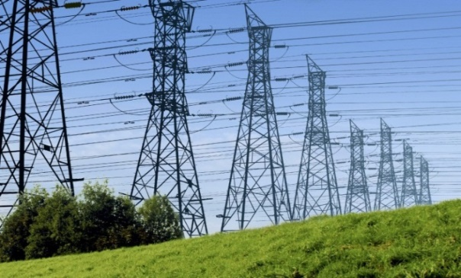
Why focus on hydrogen?
Society and environment One buried gas pipeline (ø 1.2 m) transports same amount of energy as eight parallel high-voltage pylons (each 3 GW).
Hydrogen can be green Production and consumption can be provided carbon-free.
Efficiency Sector coupling with power-to-gas is efficient even though conversion of power to gas causes losses.
Cost P2G using excess wind power is cheapest option.

Slide 16
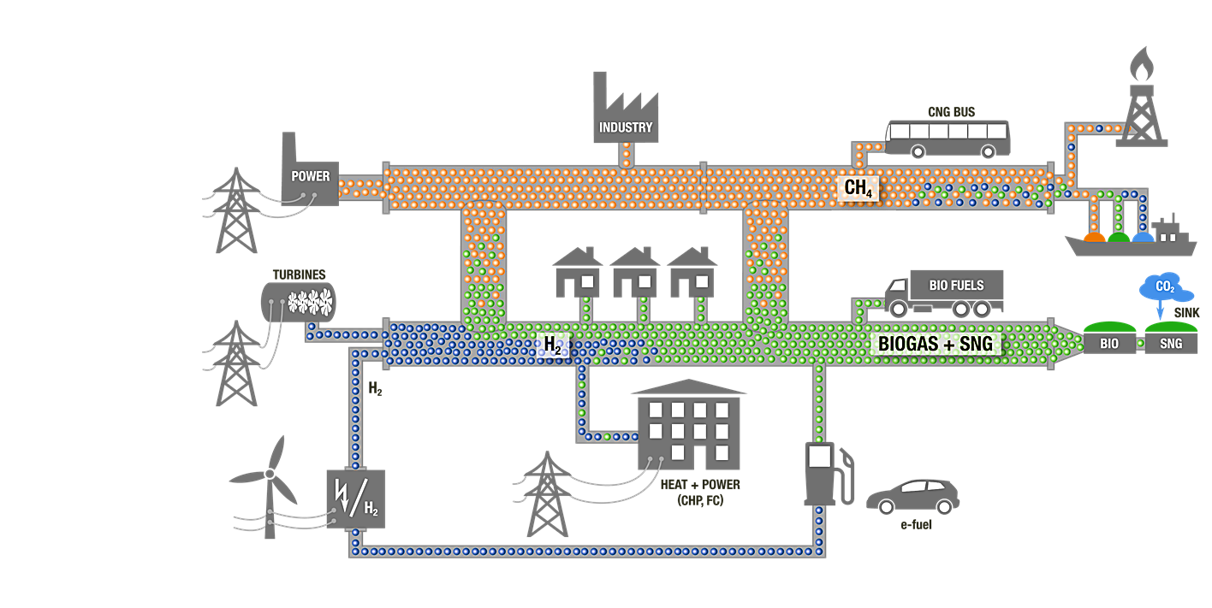
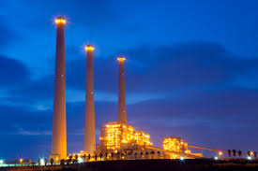
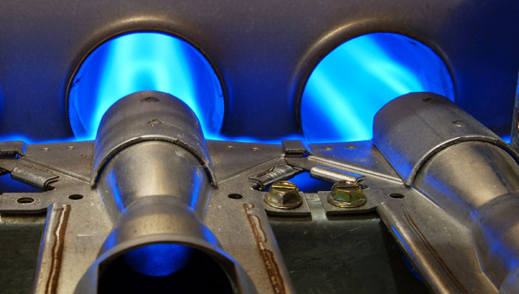
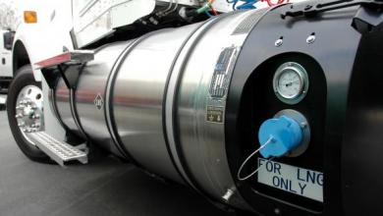
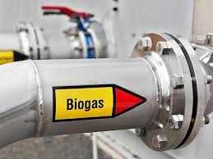
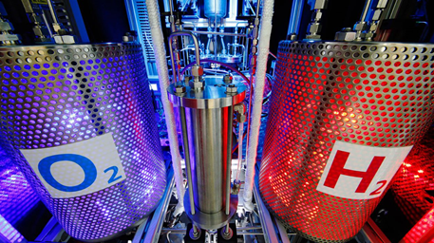
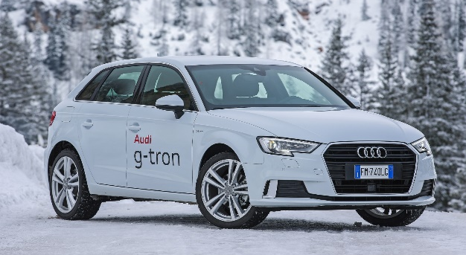
TSOs are turntable for robust, affordable, sustainable energy future “towards Paris”.
Power Sector
Heat Sector
Transport Sector
Fuel
Switch
Coal → Gas
Oil → Gas
Diesel → CNG/LNG
Content Switch
Natural Gas → Biogas / Syngas / Hydrogen
Modal
Switch
e-fuels
Power2Gas
CHP
F-Cell
Efficiency
Source: DVGW 2019

Slide 17
TSOs need to be proactive
Lobby MEPs, EU, industry associations
Have clear policy asks, such as:
Clear positive signals regarding the role of gas in future energy mix.
Roadmap for renewable and decarb gases including role of importers.
Well-interconnected, diversified and functioning internal gas market.
Equal treatment of technologies to enable successful integration of all gases.
Holistic approach to optimisation and investment planning across full energy system: “coupled regulation” to support efficient sector coupling.
International certificate system for trade of renewable and climate-neutral gases.
Quotas for renewable / climate neutral gases combined with a sequential market program.
Entitlement for TSOs to own and operate P2G plants to provide most cost-efficient conversion services of energy carriers in a non-discriminatory way.
Incentives for energy traders to use P2G for optimise portfolio (eg interim storage of energy).
Incentives for R&D investment.
Sustainable finance label for investments related to transport of renewable and decarb gases.
Notes:
Be proactive with
associations,
MEPs and Brussels reps,
clear policy asks,
show innovation and
Show how you are planning for decarbonisation

Slide 18
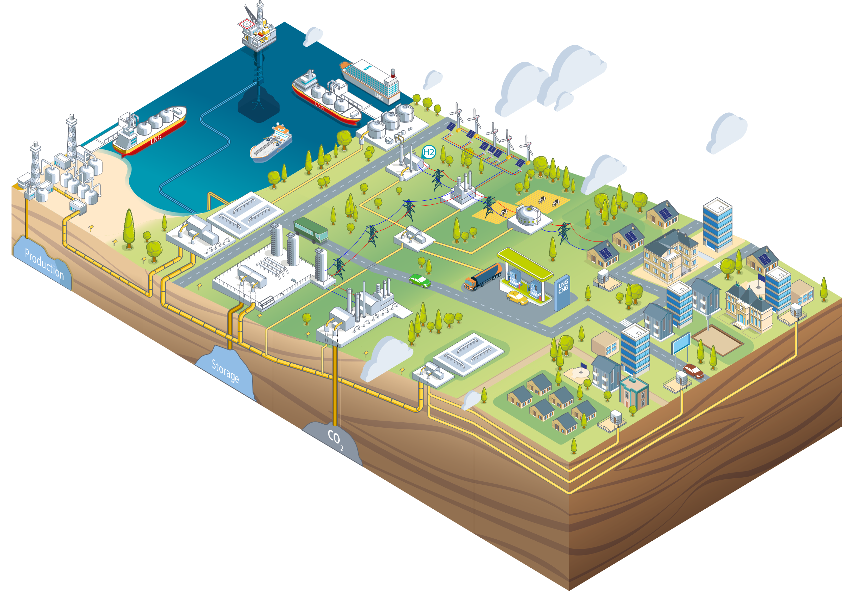
Thank you

